Slide 1
GPNZ and Hospital &Specialist Services Planned Care Patient Communication Initiative Derek Sherwood & Campbell Brebner & Stephen Lavery Liaison session: 16 May 2024

Slide 2
Introductions
Derek Sherwood
Clinical Lead, Planned Care, Hospital and Specialist Services
Ophthalmologist, Nelson Marlborough District
Campbell Brebner
Chief Medical Advisor, Primary & Integrated Care, Te Whatu Ora Counties Manukau
GP
Member of Patient Communication project’s expert advisory group
Stephen Lavery
System Design Manager, Living Well, Te Whatu Ora National Commissioning
Member of Patient Communication project’s expert advisory group

Slide 3
Overview
Topics
Current wait list
Patient Communication Project
Expected wait time dashboards
Clinical Pathways
Clinical Prioritisation & Access Criteria
Q&A, discussion, next steps
Continued liaison

Slide 4
Overview
Our intentions
We want to improve the information we share with primary care to support a systems, collaborative approach to addressing shared issues related to wait times and other activities
We want to be more active in our engagement with primary care to hear directly from you about our shared issues and opportunities for improvement
We recognise that, sometimes, it may not seem that we are doing this well as we intend to and want to improve

Slide 5
Current Wait Lists
What’s happening right now with wait lists?
18,000 more people, referred for surgery by their General Practitioner, were seen for their first specialist assessment at the end of December 2023, compared to the previous year - a 6% increase over the previous year
There were 11,000 more planned care surgeries at the end of December 2023, compared to the previous year - a 5 % increase over the previous year
However, there are still people who are long-waiting and not receiving care within the target time frame of four months:
Notes:
ESPI2 long waiters
Total list 85,033
Priority 3 71% 4-9 months
Priority 2 78% 4-9 months
ESPI5 long waiters
Total list 30,086
Priority 3 77% 4-9 months
Priority 2 71% 4-9 months
Last year, a project was initiated to improve communication with these long-waiting people, while HSS continues strong focus on reducing wait times and wait lists

Slide 6
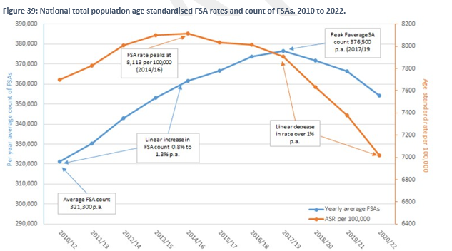

Slide 7
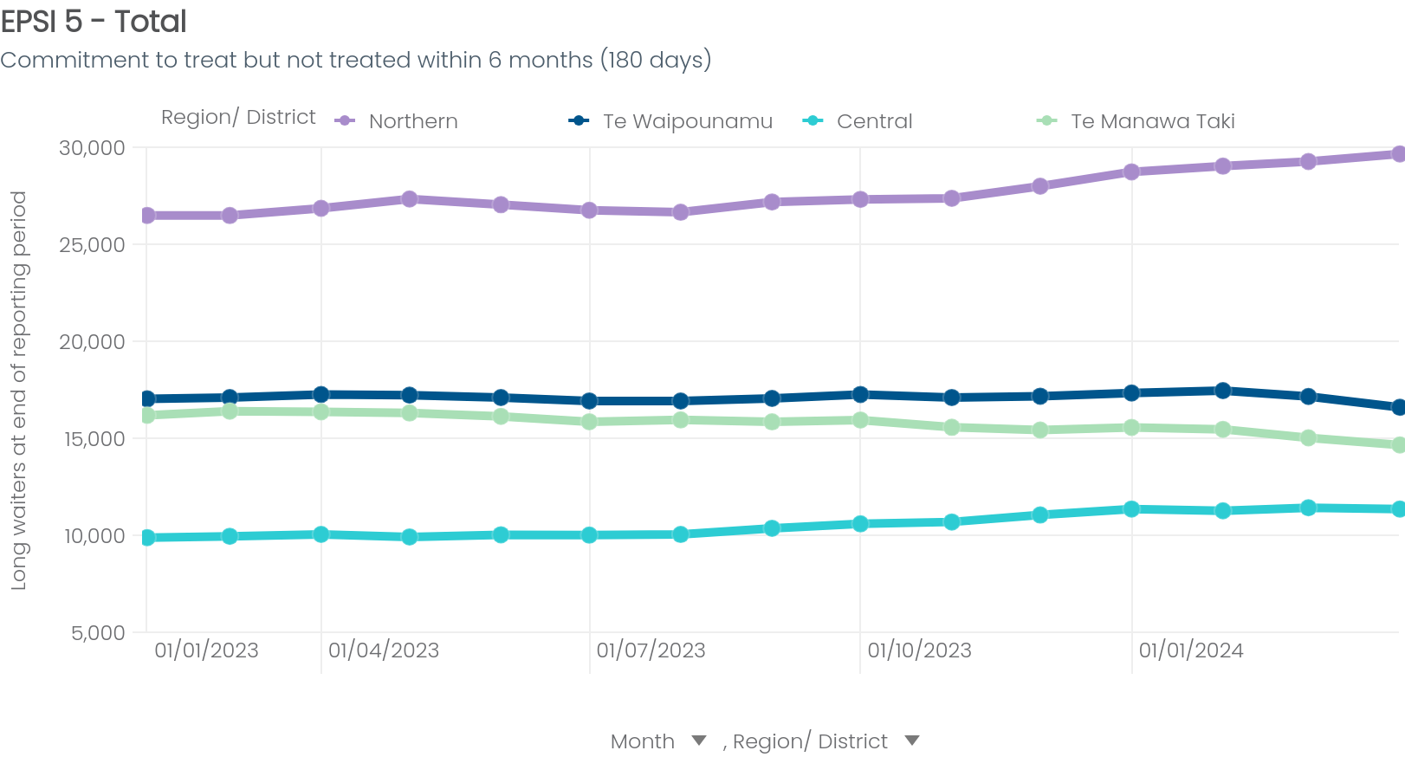
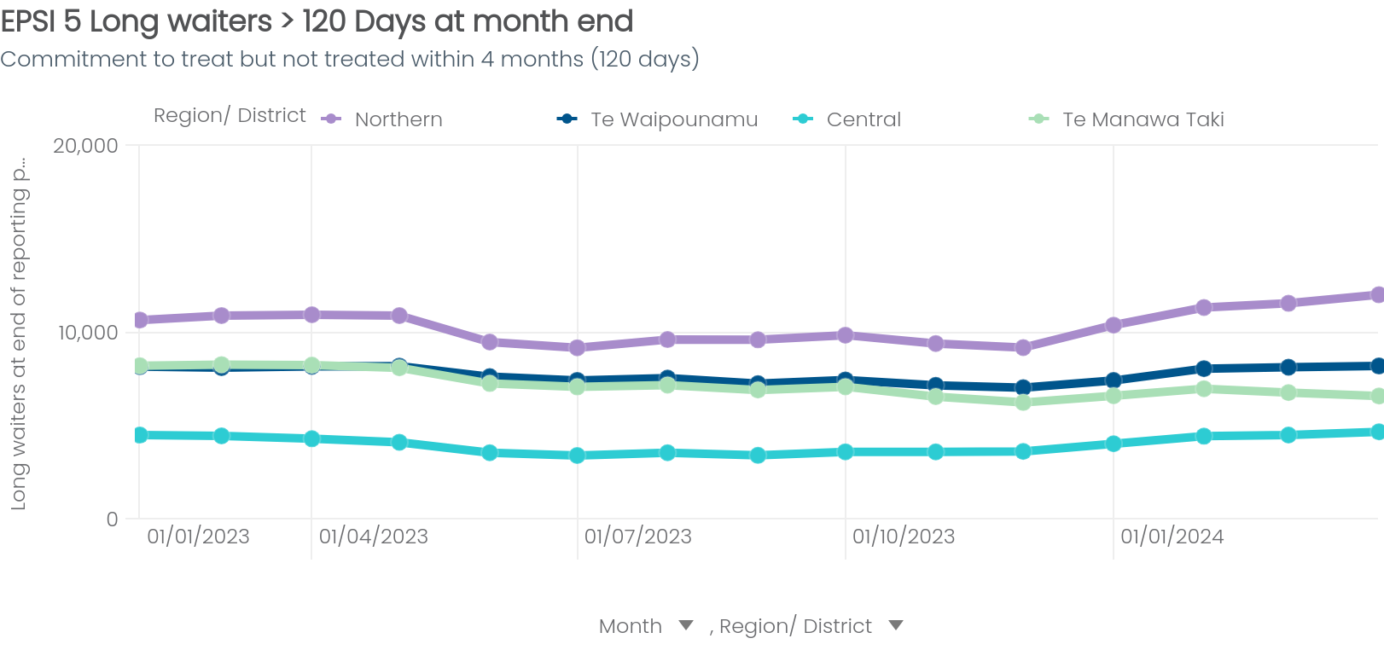
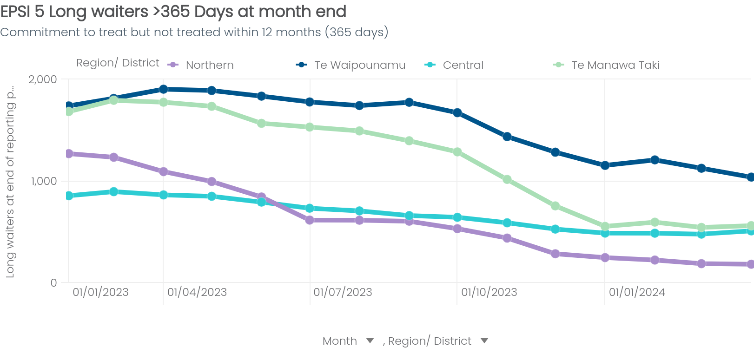
National view of ESPI 5 performance, by Region
Northern
Te Manawa Taki
Central
Te Waipounamu
ESPI 5 Total
ESPI 5 > 120 days
Mar 24 End of month
72,713
Feb 24 End of month
73,144
Change
-430
Mar 24 End of month
31,260
Feb 24 End of month
31,453
Change
-193
ESPI 5 > 365 days
Observations
Actions
Mar 24 End of month
2,342
Feb 24 End of month
2,510
Change
-168
Noticeable increase in 2024 for ESPI 5 > 120 days for Northern
ESPI 5 Total waitlists remain relatively consistent over time for all regions
Plateau in ESPI 5 > 365 days across the regions in 2024 after steady decline through the back end of 2023
Maximise theatre utilisation
Clinical prioritization & waiting list
Treatment management quality and compliance stood up
Drive down cancellations – balance with acute care, productivity component
Data extracted from RAPID as at 08/04/2024
Notes:
11000 more procedures ( 5% ) increase but 12000 moe acute procedures ( 9%)

Slide 8
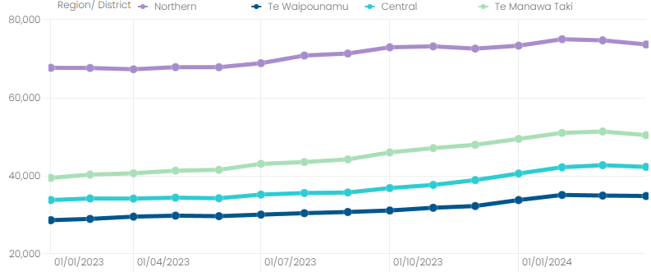
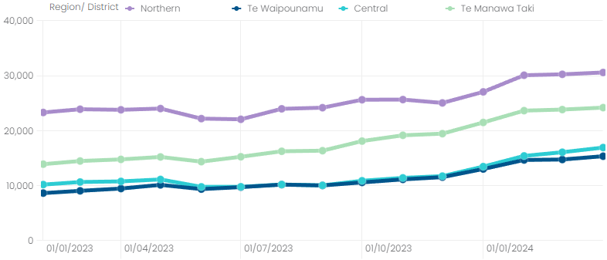
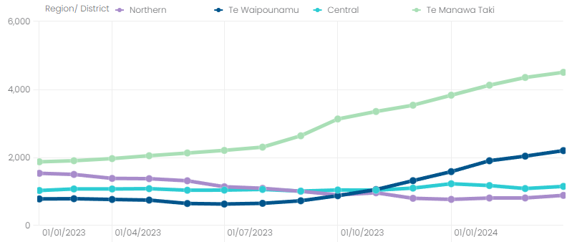
National view of ESPI 2 performance, by Region
Northern
Te Manawa Taki
Central
Te Waipounamu
ESPI 2 Total
ESPI 2 > 120 days
Mar 24 End of month
203,195
Feb 24 End of month
204,443
Change
-1,238
Mar 24 End of month
86,520
Feb 24 End of month
86,311
Change
+210
ESPI 2 > 365 days
Observations
Actions
Mar 24 End of month
8,621
Feb 24 End of month
8,305
Change
+316
Te Manawa Taki has seen a dramatic increase in ESPI 2 > 365 waitlist in the last 12 months.
All regions showing steady increases in ESPI 2 >120
Treatment management quality and compliance stood up
Clinical prioritization & access thresholds defined nationally (process)
Review and improve data quality
Productivity - Booking processes, throughput, staffing review
Data extracted from RAPID as at 09/04/2024
Notes:
18000 more FSAs 6% increase but 110000 ED attendances ( 9% ) increase

Slide 9
Patient Communication Project
Objectives
Achieve a nationally consistent approach to communicating with people waiting longer than 4 months for a first specialist assessment or treatment
Contribute to data validation of the wait lists
Increase transparency of the wait time for service delivery

Slide 10
Patient Communication Project
Pilot, May 2023
Focussed on people waiting >4 months for treatment in all specialties
Primary Care informed about initiative
Summary:
20,339 people received communication-mainly letters
2,717 responded – 13.36% response rate
466 people were removed from the wait list (2.29%)

Slide 11
Patient Communication Project
Targeting
Following a pause to allocate project resources, currently targeting people waiting over 4 months for a first specialist assessment (FSA) in General Surgery, Gynaecology, Ophthalmology, Orthopaedics
Primary care informed about this stage of the project - need a longer lead in time and to connect with networks like this one to communicate activities
17,759 national total in this patient cohort (@15 April)
Contact between 6 May-30 June 2024
Local teams using nationally consistent wording-tailoring to local context using text, email, phone calls, letters. Reminding people to contact GPs if condition changes
Patients contacting local hospital teams to update details

Slide 12
Patient Communication Project
Phased Implementation
Further specialties will be targeted after June
Will also include people waiting over 4 months for treatment as well as FSA after June
Once all people on the current list have been contacted, intention is to start a ‘BAU’ process
Each person receives a standard communication at scheduled milestones - when they have been waiting >4 months and then every 4 months if they remain on the list
acknowledge continued delay, reassure them they remain on the wait list and request they contact Planned Care to update details if needed
This will be automated where technically possible
A nationally consistent process will be implemented in close collaboration with local districts and booking teams
Maintain active contact with primary care on progress and plans

Slide 13
Expected Wait Time Dashboards
We are working on making things easier to see for you
Expected Wait Time Dashboards
We are working on making wait times easier for GPs to access
Contribute to increased transparency about wait times
New Dashboard on Health Pathways channel – 1 July 2024
Dashboard:
Time people waited who received an FSA or treatment within the previous three months
People in the ‘routine’ clinical category
Average, 95th percentile
By specialty and by district
Updated monthly
Will it be useful for you if we also include this information for the semi-urgent clinical category?

Slide 14
Other Planned Care activities
Update on other Planned Care activities
Clinical pathways – FIT for symptomatic, MSK Pathway
Clinical Prioritisation & Access Criteria

Slide 15
What next?
Q&A, Discussion, Next Steps

